Slide 1

Chapter 1
Introduction
Copyright © The McGraw-Hill Companies, Inc. Permission required for reproduction or display.

Slide 2
OBJECTIVES:
To give a brief history of the Internet.
To give the definition of the two often-used terms in the discussion of the Internet: protocol and standard.
To categorize standard organizations involved in the Internet and give a brief discussion of each.
To define Internet Standards and explain the mechanism through which these standards are developed.
To discuss the Internet administration and give a brief description of each branch.

Slide 3
Chapter
Outline
1.1 A Brief History
1.2 Protocols and Standards
1.3 Standards Organizations
1.4 Internet Standards
1.5 Internet Administration

Slide 4
1-1 A BRIEF HISTORY
A network is a group of connected, communicating devices such as computers and printers. An internet is two or more networks that can communicate with each other. The most notable internet is called the internet, composed of hundreds of thousands of interconnected networks. Private individuals as well as various organizations such as government agencies, schools, research facilities, corporations, and libraries in more than 100 countries use the Internet.

Slide 5
Topics Discussed in the Section
ARPANET
Birth of the Internet
TCP/IP
MILNET
CSNET
NSFNET
ANSNET
The Internet Today
World Wide Web
Growth of the Internet

Slide 6
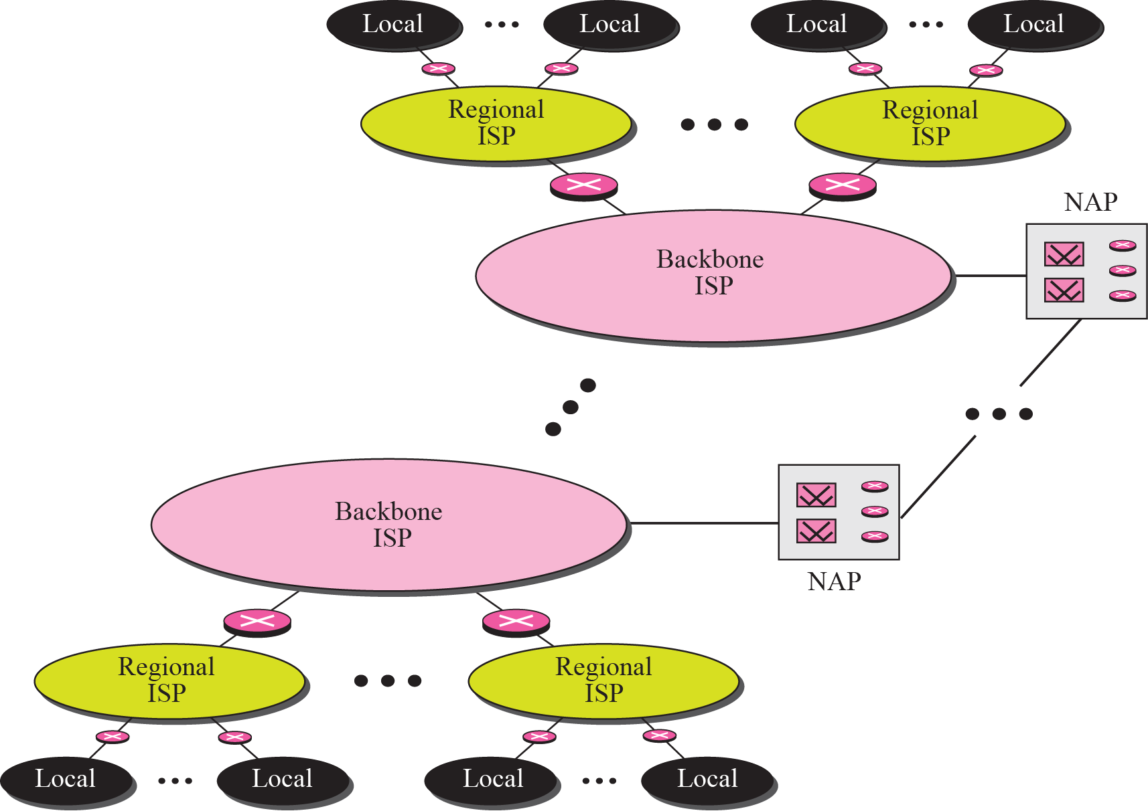
Figure 1.1 Internet today

Slide 7
1-2 PROTOCOLS AND STANDARDS
In this section, we define two widely used terms: protocols and standards. First, we define protocol, which is synonymous with “rule.” Then we discuss standards, which are agreed-upon rules.

Slide 8
Topics Discussed in the Section
Protocols
Standards

Slide 9
1-3 STANDARDS ORGANIZATION
Standards are developed through the cooperation of standards creation committees, forums, and government regulatory agencies.

Slide 10
Topics Discussed in the Section
Standards Creation Committees
Forums
Regulatory Agencies

Slide 11
1-4 INTERNET STANDARDS
An Internet standard is a thoroughly tested specification that is useful to and adhered to by those who work with the Internet. It is a formalized regulation that must be followed. There is a strict procedure by which a specification attains Internet standard status. A specification begins as an Internet draft. An Internet draft is a working document with no official status and a six-month lifetime.

Slide 12
Topics Discussed in the Section
Maturity Levels
Requirement Levels

Slide 13
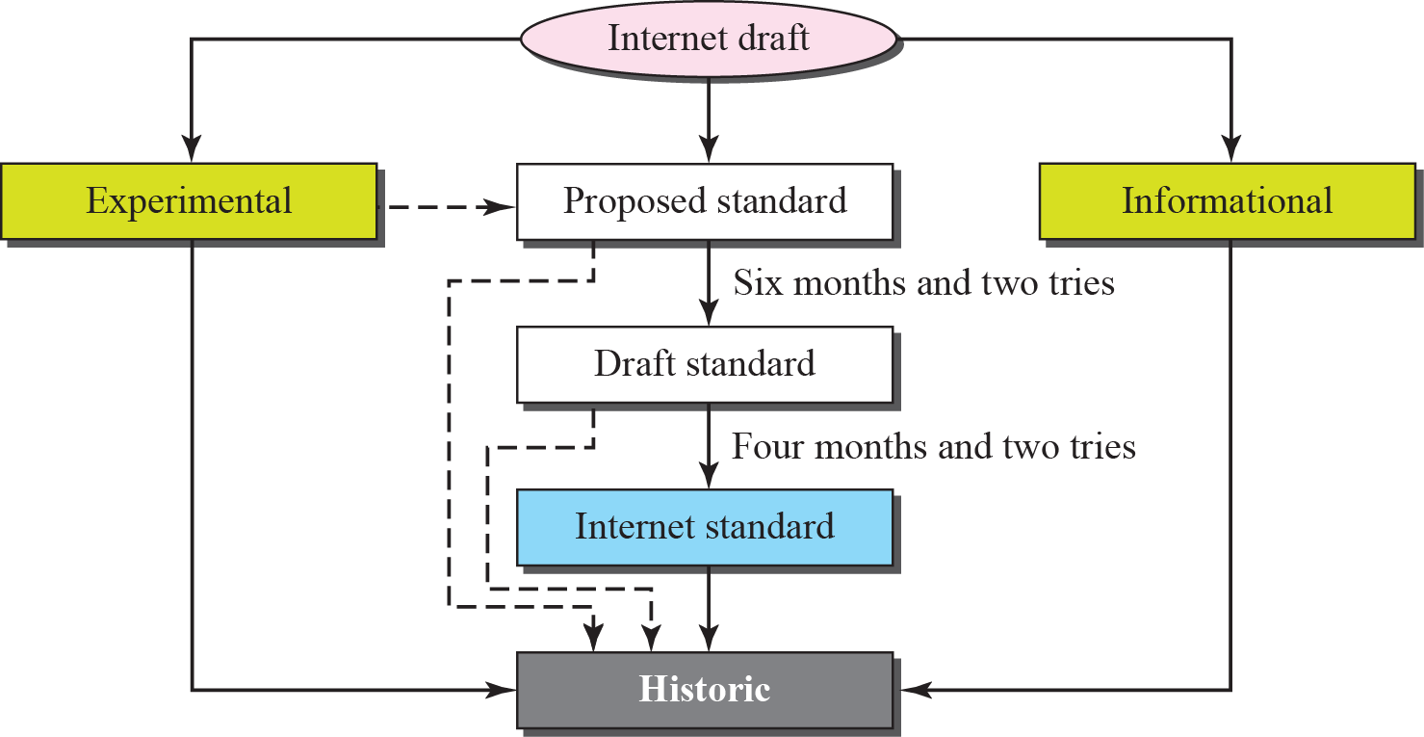
Figure 1.2 Maturity levels of an RFC

Slide 14
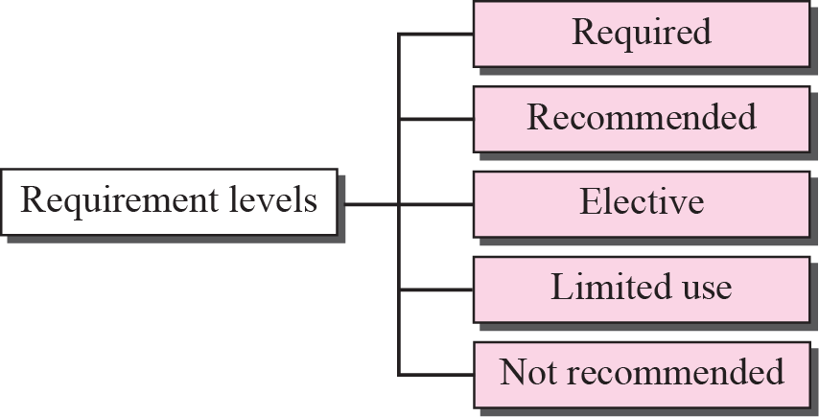
Figure 1.3 Requirement levels of an RFC

Slide 15

Note
RFCs can be found at
http://www.rfc-editor.org.

Slide 16
1-5 INTERNET ADMINISTRATION
The Internet, with its roots primarily in the research domain, has evolved and gained a broader user base with significant commercial activity. Various groups that coordinate Internet issues have guided this growth and development. Appendix G gives the addresses, e-mail addresses, and telephone numbers for some of these groups. Figure 1.4 shows the general organization of Internet administration.

Slide 17
Topics Discussed in the Section
Internet Society (ISOC)
Internet Architecture Board (IAB)
Internet Research Task Force (IRTF)
Internet Assigned Number Authority (IANA)
Internet Corporation for Names and Numbers
(ICANN)
Network Information Center (NIC)

Slide 18


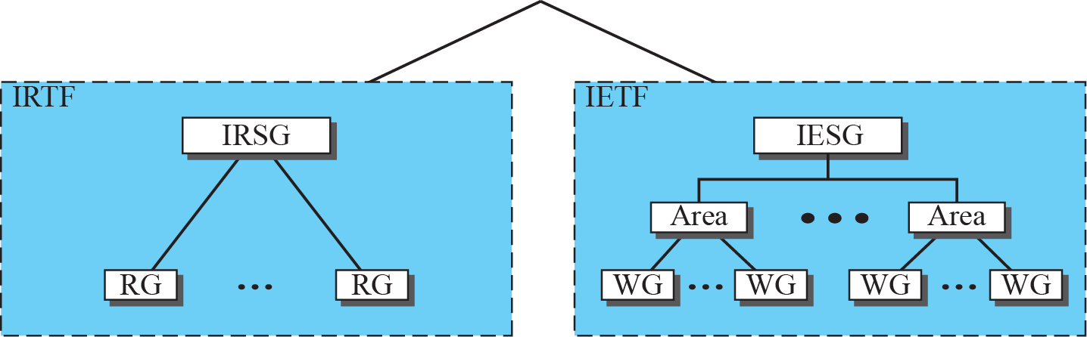
Figure 1.4 Internet administration

Slide 19
Note
The addresses and websites for Internet organizations can be found in
Appendix G.

